Slide 1
Annual Awards for Excellence in Education
Tuesday, May 24, 2022
www.chesapeakechamber.org

Slide 2
Program
Welcome
Sophia Montgomery, Chamber Board Chair, Director of Sales, Country Inn & Suites Baltimore North
Greetings
Darryl Williams, Ed.D., Superintendent, Baltimore County Public Schools
Sandra Kurtinitis, Ph.D., President, Community College of Baltimore County
Award Presentations
Closing Remarks
Julie Gaynor, Chamber Board Member, Co-Chair, Workforce Development Committee
Sharon Kihn, Chamber President
Reception

Slide 3
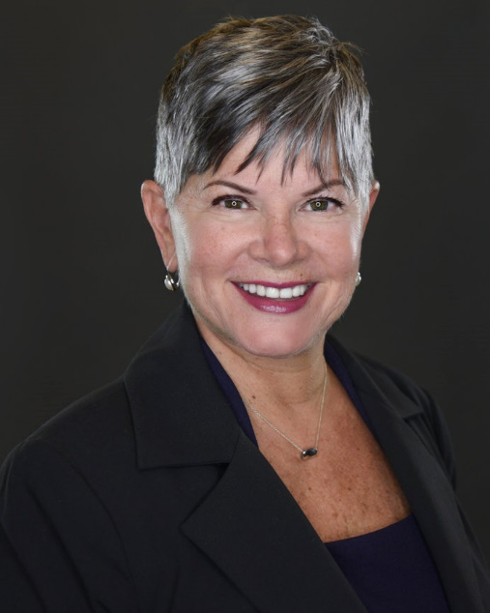
Welcome
On behalf of the Chesapeake Gateway Chamber of Commerce, Johns Hopkins Bayview Medical Center, the Community College of Baltimore County, and our other wonderful sponsors, I’d like to thank you for joining us for this special Awards for Excellence in Education ceremony.
The Chesapeake Gateway Chamber of Commerce is very proud to have served Essex, Middle River, White Marsh and the surrounding areas for over 70 years. This event honors teachers and support professionals from our community, who have made an outstanding contribution to education.
Our finalists have been selected, because they:
· Direct and/or participate in leadership tasks, extra-curricular programs and special activities in the school and community
· Create a quality and innovative learning environment for all students
· Demonstrate a supportive and caring attitude toward students and/or colleagues
· Make a significant impact on education in a variety of ways
We are very proud of our schools and our students! We are excited about this opportunity to acknowledge the efforts of the individuals responsible for the success of those schools and students. We know how hard our teachers, support professionals and school administrators work, and we appreciate the importance of their role with our future workforce.
Thank you for participating in this celebration.
A Message from Chamber Board Chair Sophia Montgomery

Slide 4
Sponsors A sincere thank you goes to all our sponsors and donors. Without your support, this event would not be possible.
Foundation Gold
Silver Bronze
The Romadka
Family Partnership

Slide 5
Event Donors
Baltimore County Public Schools
Chick-fil-A Eastpoint
Cockpit in Court
Community College of Baltimore County
Freedom Federal Credit Union
J&H Tires, Inc.
Johns Hopkins Bayview Medical Center
MedStar Franklin Square Medical Center
Minuteman Press of Canton, Federal Hill & Crofton
Pizza John’s
Al Pollard
Potomac Pizza Grill
Reeder Insurance
The Berkleigh
Two Guys Grill & Pub
Ultimate Watersports

Slide 6
Selection Process
Principals at all Chesapeake Gateway Chamber member schools have an opportunity to nominate an educator and a support person, and CCBC deans can nominate one professor from each department for the Awards for Excellence in Education.
All content which could identify the nominee or school is eliminated on all applications before scoring the nominations to keep everything fair and anonymous.
Nominations are scored by members of the Workforce Development Committee. Committee members from high school do not evaluate high school nominees, and CCBC committee members do not evaluate CCBC nominees.
Judges look for individuals who go above and beyond their job descriptions, implement unique and creative activities in their schools, contribute to the total school community and stand out in their fields.
Recipients of this year’s awards include two top educators and two support staff members from K-12 schools and one professor from CCBC. Thanks to our generous sponsors, they will each receive $250.

Slide 7
Finalists Teachers
Baltimore County
Public Schools

Slide 8
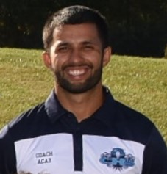
Chris Acab
Dependable, Respectful, Diligent, Dedicated
Chesapeake High School
Years Teaching: 3
Physical Education (Grades 9-12), Health (Grade 12)

Slide 9
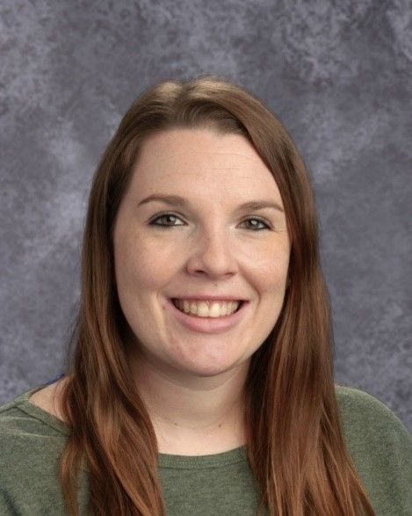
Amber Glover
Perceptive, Creative and Empathetic
Crossroads Center
Years Teaching: 12
Department Chair & Teacher, Science Department

Slide 10
Jason Handlir
Energetic, Supportive, Dependable
Deep Creek Middle School
Years Teaching: 17
Grade 6 World History

Slide 11
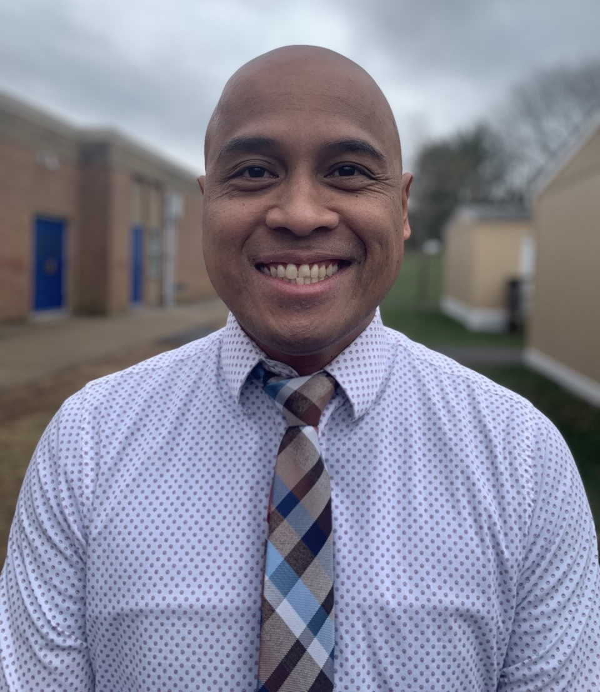
Richard Hinal
Charismatic, Caring,
Hard-working
Shady Spring Elementary School
Years Teaching: 7
Grade 5 Math & Science

Slide 12
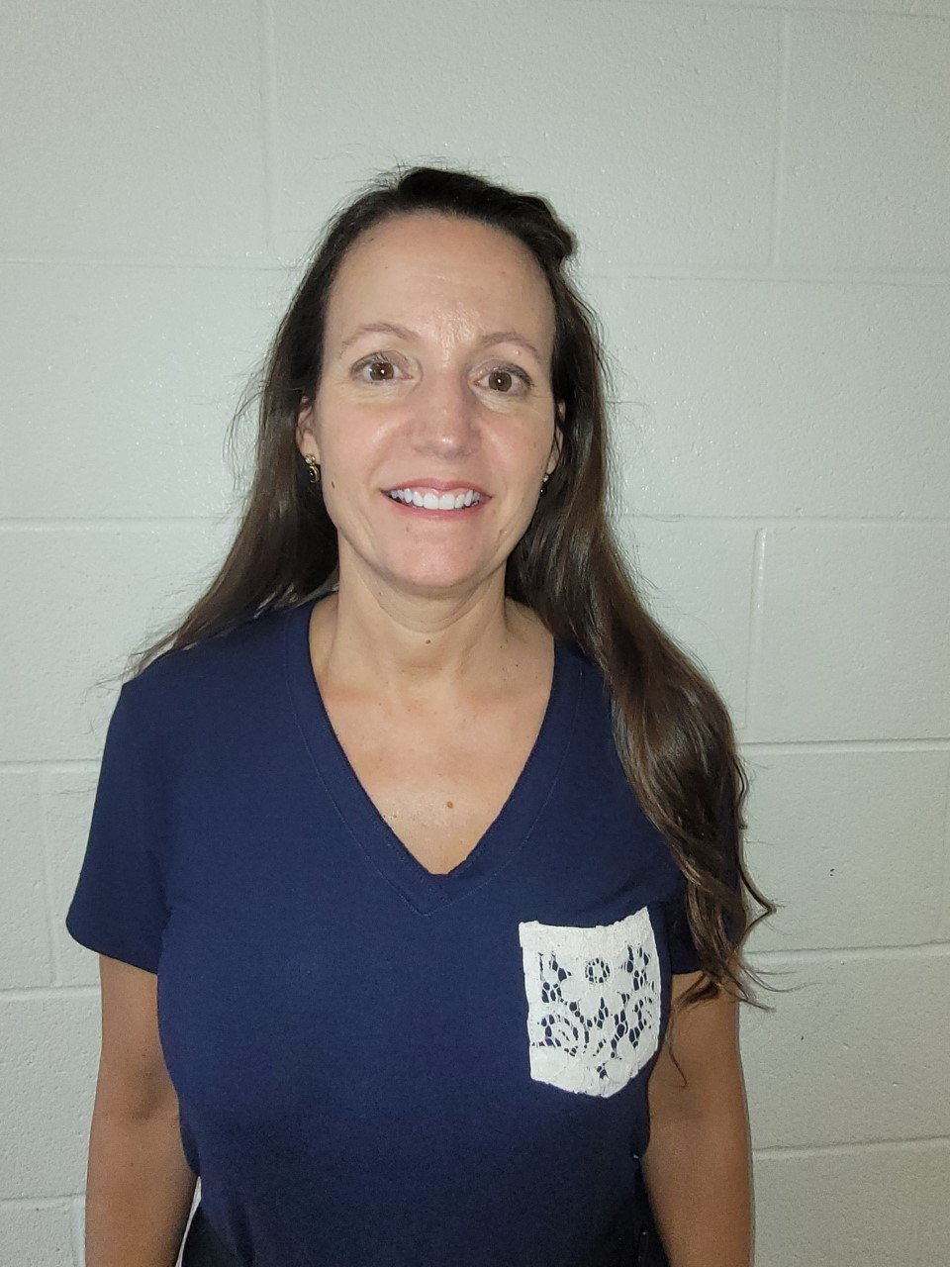
Renee Johannes
Dedicated, Passionate, Resourceful, Compassionate
Essex Elementary School
Years Teaching: 29
Grade 4 – All Subjects

Slide 13
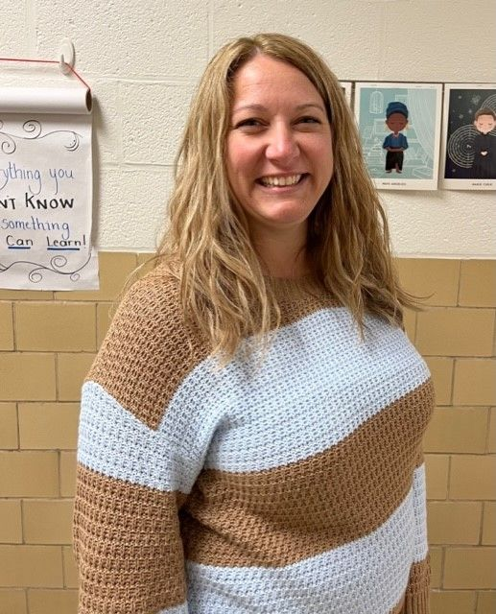
Elizabeth McLaughlin
Committed, Reflective, Creative
Mars Estates Elementary School
Years Teaching: 7
Grade 3, All Subjects

Slide 14
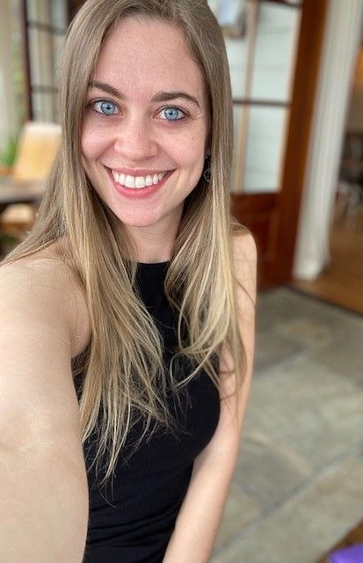
Veronica Rider
Leader, Positive, Supportive
Hawthorne Elementary School
Years Teaching: 9
Kindergarten

Slide 15
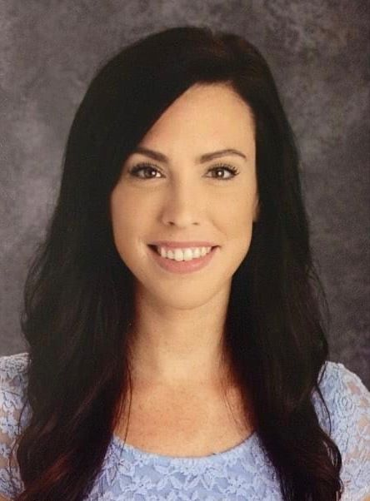
Lindsay Schulz
Dedicated, Creative, Organized, Collaborator
Sandalwood Elementary School
Years Teaching: 10
Grade 3

Slide 16
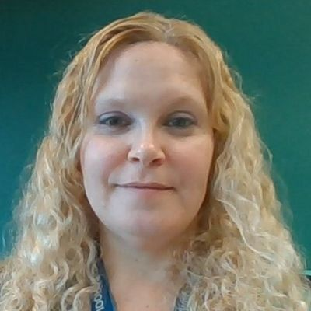
MaryEllen Sittner
Outstanding, Dedicated, Supportive, Caring, Team Player
Kenwood High School
Years Teaching: 16
Staff Development/ELA Teacher

Slide 17
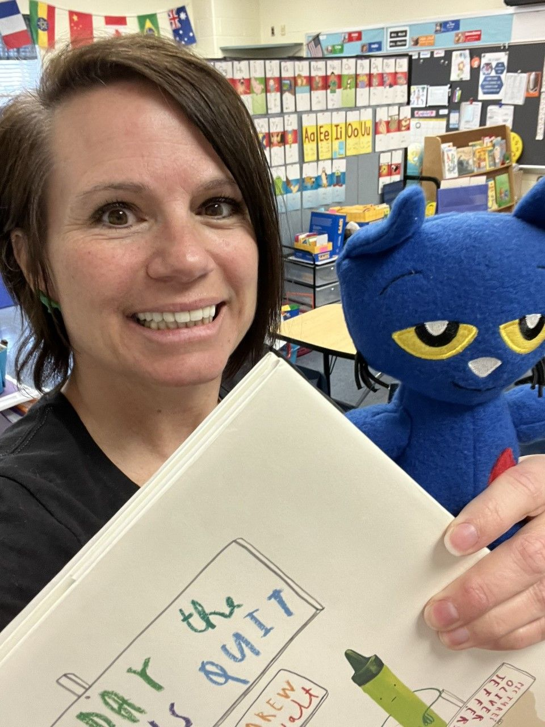
Dawn Sollenberger
Dedicated, Student Centered, Advocate
Martin Boulevard Elementary School
Years Teaching: 21
Reading Specialist

Slide 18
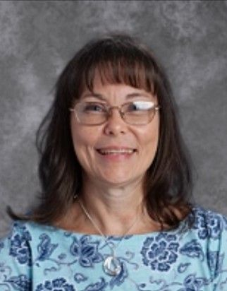
Richelle Sprouse
Passionate, Collaborative, Invested
Orems Elementary School
Years Teaching: 31
Grade 1

Slide 19
Recipients Teachers
Baltimore County
Public Schools

Slide 20
CONGRATULATIONS
Chris Acab
Mars Estates Elementary School

Slide 21
CONGRATULATIONS
Elizabeth McLaughlin Mars Estates Elementary School

Slide 22
Finalists Professors
Community College of Baltimore County

Slide 23
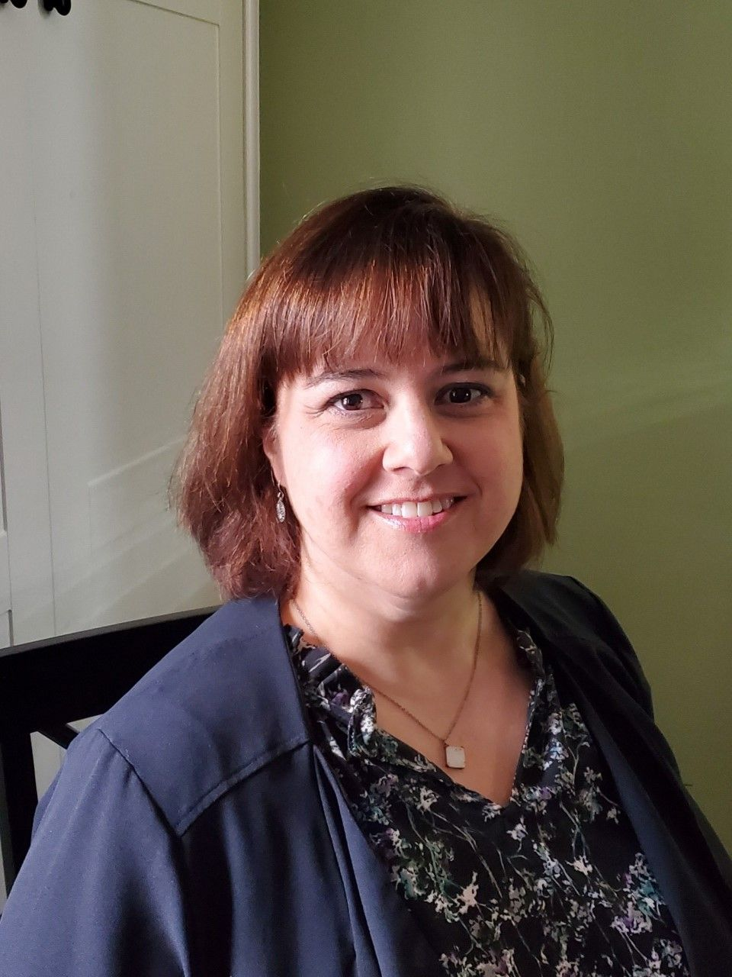
Jessica Brown-Strott
Energetic, Student-Centered, Motivating, Resourceful, Reliable
Department: Teacher Education
Expertise: Elementary Education, Literacy, Supporting Initiative to Recruit & Retain Teachers
Years at CCBC: 7

Slide 24
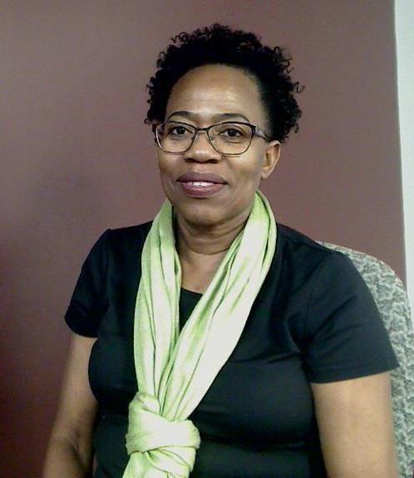
Dr. Pauline Hamilton
Intelligent, Student-oriented, Fiercely Independent, Missed Dearly
Department: Physical Science
Expertise: Chemistry
Years at CCBC: 12

Slide 25
Recipient Professors
Community College of Baltimore County

Slide 26
Congratulations
Jessica Brown-Strott
Teacher Education Department

Slide 27
Finalists Support Professionals
Baltimore County
Public Schools

Slide 28
Laurey Dobson
Compassionate, Hard working, Dependable
Shady Spring Elementary School
Years in Current Assignment: 4
Nurse

Slide 29
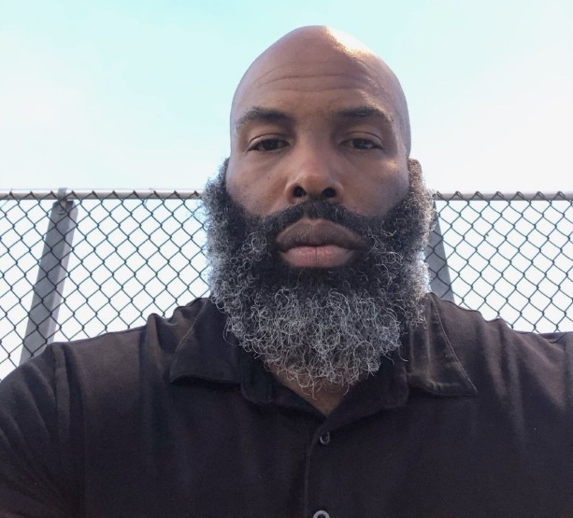
David DuBose
Team Player, Flexible, Calm Demeanor
Sandalwood Elementary School
Years in Current Assignment: 4
Paraeducator

Slide 30
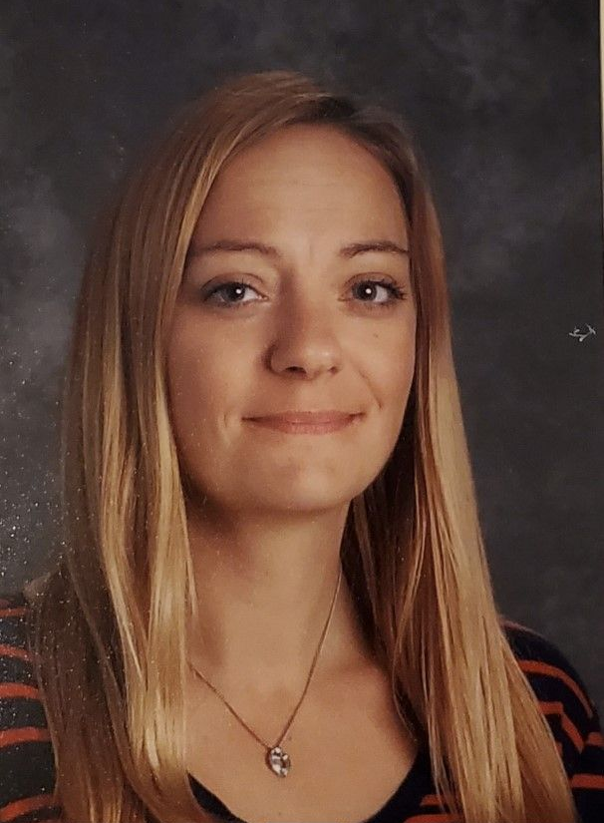
Amy Eubert
Dedicated, Caring, Knowledgeable
Orems Elementary School
Years in Current Assignment: 9
Early Childhood Paraeducator

Slide 31
Kristina Johns
Creative, Friendly, Supportive
Hawthorne Elementary School
Years in Current Assignment: 6
Support Staff/Assistant Educator with Early Childhood Department

Slide 32
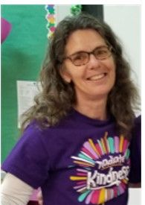
Denise Lucas
Team Player, School Advocate, Dedicated
Martin Boulevard Elementary School
Years in Current Assignment: 15
Paraeducator

Slide 33
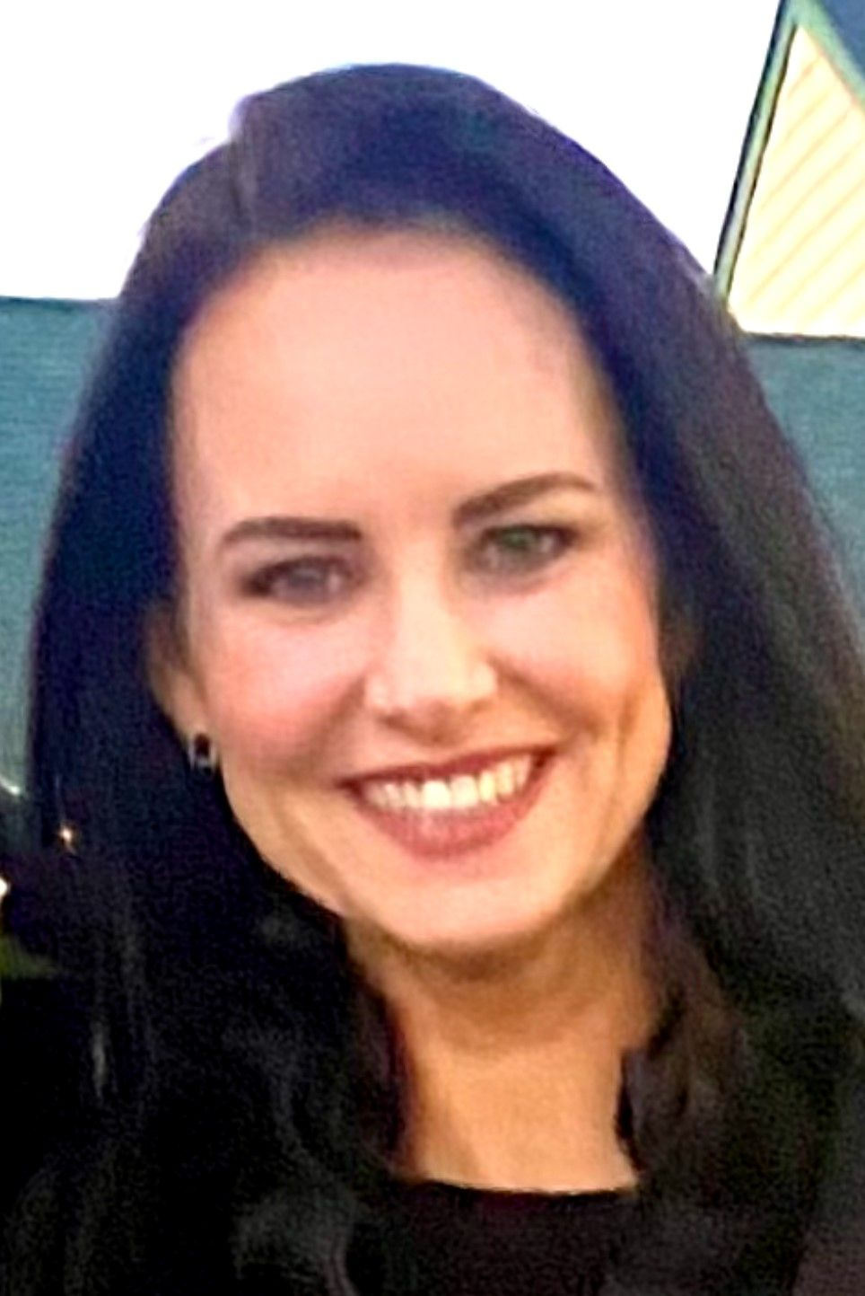
Valerie Markey
Flexible, Compassionate, Inclusive
Mars Estates Elementary School
Years in Current Assignment: 10
Speech Language Pathologist

Slide 34
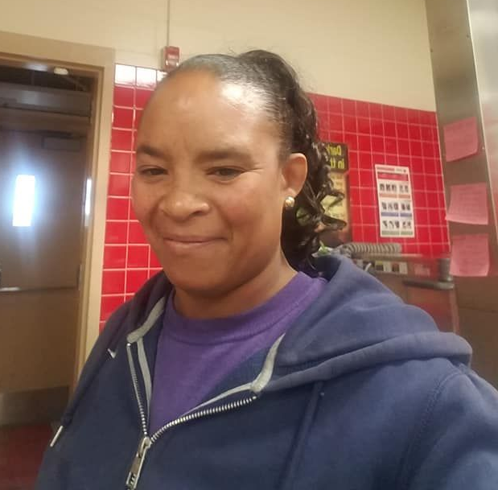
Stefanie Paige
Outgoing, Dedicated, Hard Working, Compassionate, Reliable
Kenwood High School
Years in Current Assignment: 2
Building Service Worker

Slide 35
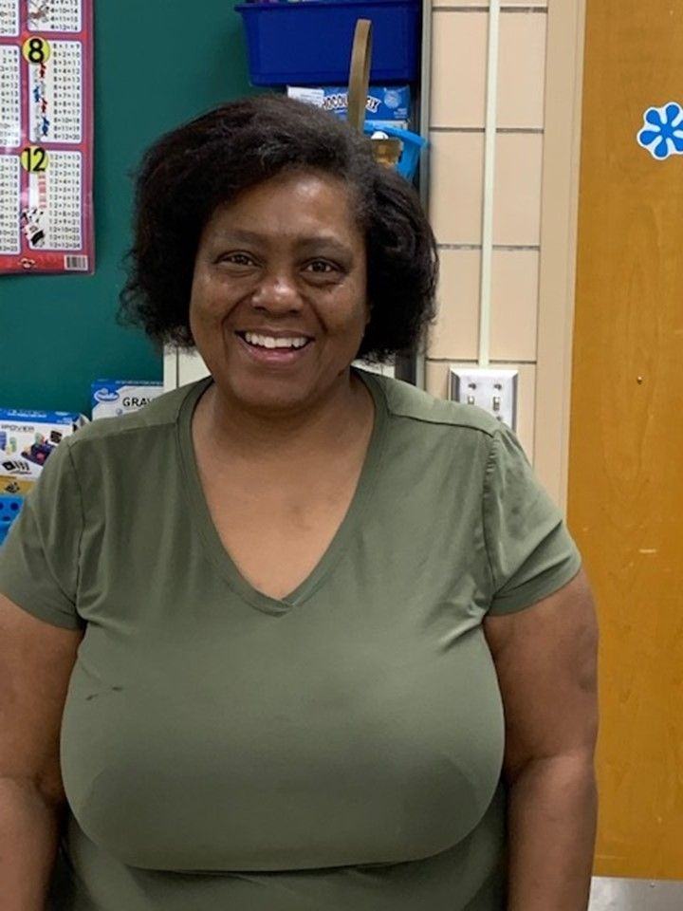
Andrea Ruffin
Caring, Supportive, Dedicated, Kind, Uniting
Deep Creek Middle School
Years in Current Assignment: 3
Paraprofessional

Slide 36
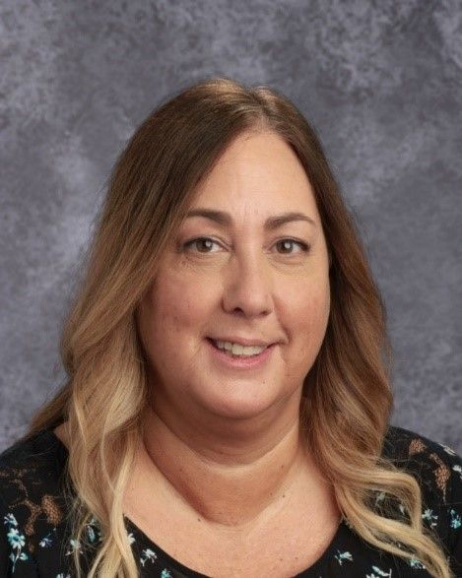
Suzanne R. Spangler
Resourceful, Empathetic, Knowledgeable
Crossroads Center
Years in Current Assignment: 3
Secretary

Slide 37
Marlene Walters
Steadfast, Respected, Eager, Compassionate
Chesapeake High School
Years in current assignment: 17
Student Support Staff & Assistant to the Athletic Director

Slide 38
Recipients Support Professionals
Baltimore County Public Schools

Slide 39
Congratulations
Amy Eubert
Orems Elementary School

Slide 40
Congratulations
Laurey Dobson
Shady Spring Elementary School

Slide 42
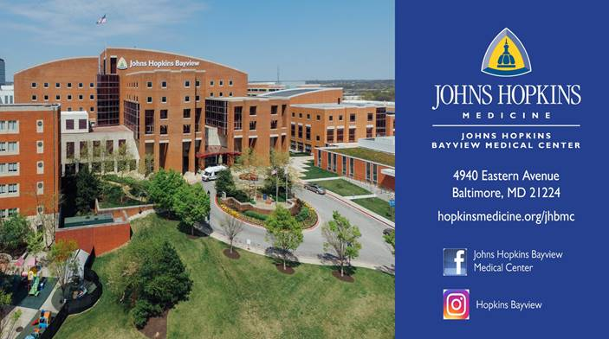

Slide 45
The Romadka
Family Partnership
is honored to sponsor the
2022 Awards for Excellence
in Education.
We wish to congratulate all nominees
and thank these outstanding educators
and support professionals
for their service
to the families of our community.

Slide 47
Thank You Workforce Development Committee
The Chamber wishes to sincerely thank the following members of the Workforce Development Committee for their dedication and ongoing commitment to important business/education partnership programs, as well as the Awards for Excellence in Education:
Julie Gaynor, Retired Educator – Co-Chair
Marc Ershler, CCBC, Essex Campus – Co-Chair
Pat Carroll, Johns Hopkins Bayview Medical Center
Emilie Cherry, CCBC, Essex Campus
Alicia Fales, BCPS-School to Career Transition, CTE
Susan Hahn, BCPS-Family & Community Engagement
Jennifer Joyner, CCBC, Essex Campus
Sharon Kihn, Chesapeake Gateway Chamber of Commerce
Steve Levy, Potomac Pizza Grill
Christy Moore, Chesapeake High School
Brian Peller, Freedom Federal Credit Union
Al Pollard, Martin State
David Ring, Maryland Insurance Administration
James Roeder, Kenwood High School
Nicholas Scalice, Chesapeake High School

Slide 48
Chesapeake Gateway Chamber of Commerce Leadership
Executive Committee:
Chair – Sophia Montgomery, Country Inn & Suites Baltimore North
Vice Chair – Mary Williams, White Marsh Mall
Secretary – Joseph Musumeci, Jr., YHB CPAs & Consultants
Treasurer -- Chelsea Morton, The Berkleigh
Immediate Past Chair – John Hess, Eastpoint Mall
Board Members: Danielle G. Alderson, Chick-fil-A Eastpoint
Marc Ershler, Community College of Baltimore Co. - Essex Campus
Benjamin Hughes, Maryland Air National Guard - 175th Wing
James Johnson, Hendersen-Webb, Inc.
Stuart Levine, MD, MedStar Franklin Square Medical Center
Steven Levy, Potomac Pizza Grill
Clifford O’Connell, Cliff’s Hi-Tech Body Shop
Alfred Pollard, Martin State Airport
Karmen Slezak, Parker, Pallett, Slezak & Russell, LLC
Rebecca Walker, St. John Properties, Inc.
Andrew Wasmer, J&H Tires
At-Large Board Members:
William Bafitis, Bafitis & Associates
Julie Gaynor, BCPS (Ret.)
Sharon Jones, Johns Hopkins Bayview Medical Center (Ret.)
James Merritt, Bmore Technology
Cecile Myrick, Crab Quarters Restaurant (Ret.)
Donna Rolnick, WPM Real Estate Mgmt./Townhomes at River’s Gate
Robert Romadka, Attorney at Law (Ret.)
President: Sharon Kihn

Slide 49
The Chesapeake Gateway Chamber of Commerce serves a beautiful area on the east side of Baltimore County, including a vast waterfront. Come dine in our restaurants, visit our parks and amenities, sail from our marinas and take advantage of our business opportunities.
Our mission is to promote an economic environment which attracts new businesses while allowing established businesses to prosper. The Chamber is dedicated to enhancing the quality of life in the region it serves by reinvesting its resources in all phases of community life.
The Awards for Excellence in Education program is an initiative of the Chamber’s Workforce Development Committee. Co-Chaired by Board member Julie Gaynor, BCPS (Ret.), and Marc Ershler, CCBC, this committee is the engine for the Chamber’s business/education partnership. The Committee consists of an extensive group of educators and business people who share a special interest in the development of youth in eastern Baltimore County.
Through this partnership, the business and education communities interact and work together to strengthen the education/business ties in the area. The goal of programs initiated and supported by the Committee and the Chamber are meant to achieve several objectives:
-- Help students develop pride in themselves and their community
-- Encourage a yearning for knowledge and scholastic achievement
-- Instill a solid value system and work ethic
-- Compel our youth to dream of a positive future
Initiatives include partnering with businesses to assist needy families, the Passion for Partnerships program and the Awards for Excellence in Education.

Slide 50
The Chamber and our members value a strong workforce, and we want to recognize our wonderful educators for the important role they play in helping students succeed. Thank You For All You Do!
405 Williams Court, Suite 108, Baltimore, MD 21220
Phone: 443-317-8763 Fax: 443-317-8772
Email: info@chesapeakechamber.org www.chesapeakechamber.org

